Slide 1
ADABOOSTER ALGORITHM
Combining multiple weak or base learners
By Amudha Raghavan

Slide 2
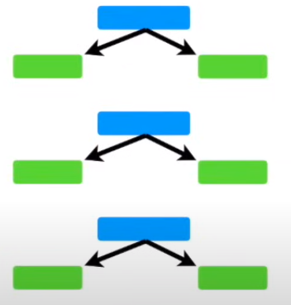
WHY YOU CHOOSE ADABOOST….. Define…
ADABOOST
Adaptive Boosting
Boosting technique used as an Ensemble Method in Machine Learning
Re-assigned to each instance, with higher weights assigned to incorrectly classified instances.

Slide 3
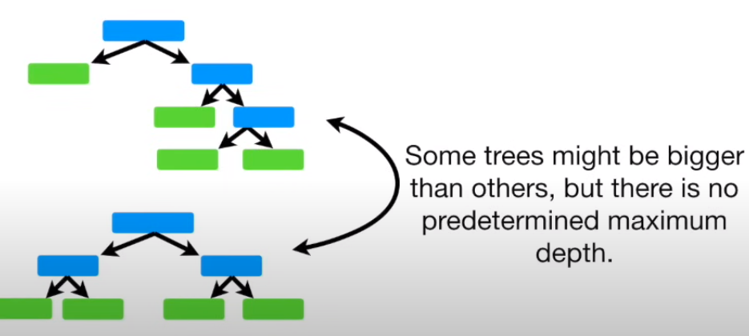
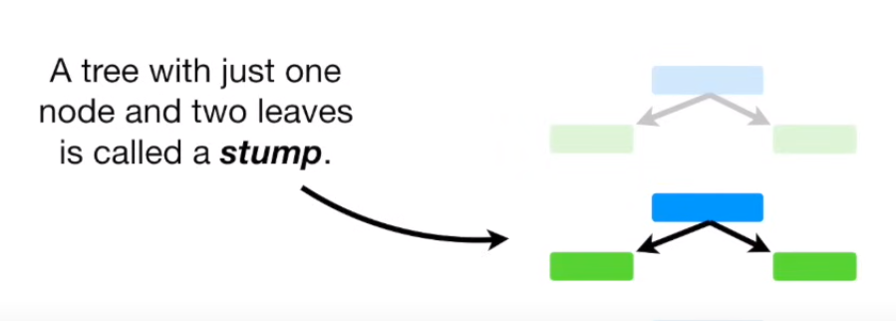
WHY YOU CHOOSE ADABOOST….. Decision Trees and Random Forests to explain – Concepts behind Adaboost
RANDOM FOREST
ADABOOST

Slide 4
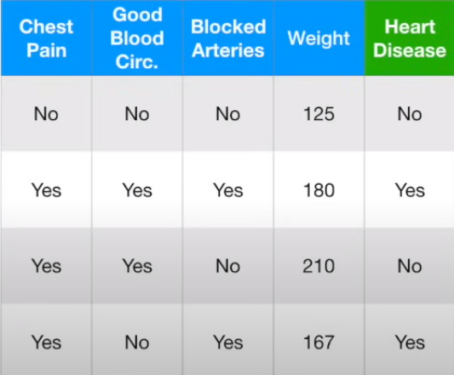
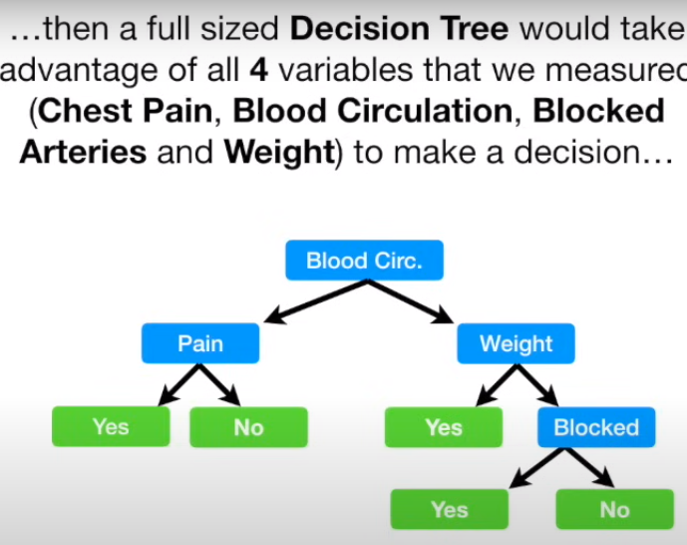
WHY YOU CHOOSE ADABOOST….. Decision Trees and Random Forests to explain – Concepts behind Adaboost

Slide 5
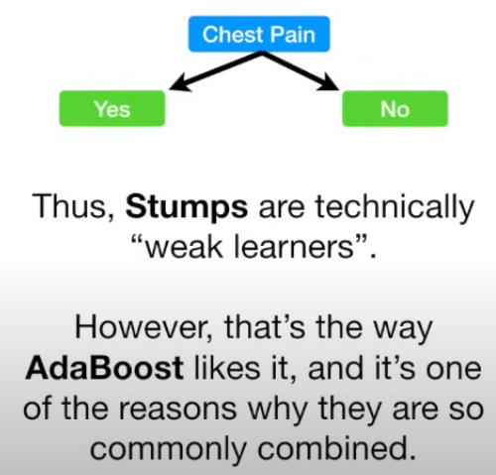
WHY YOU CHOOSE ADABOOST….. AdaBoost works….

Slide 6
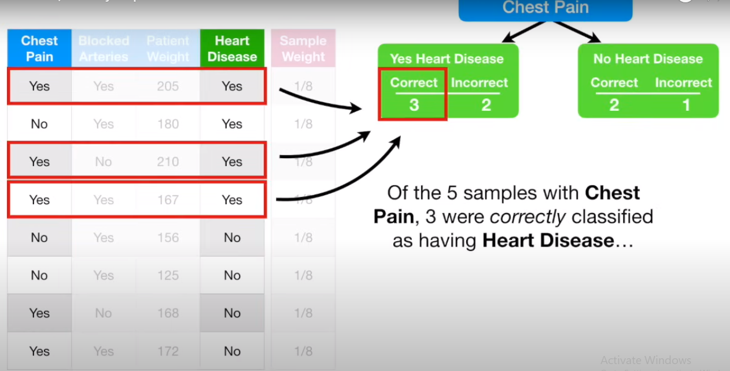
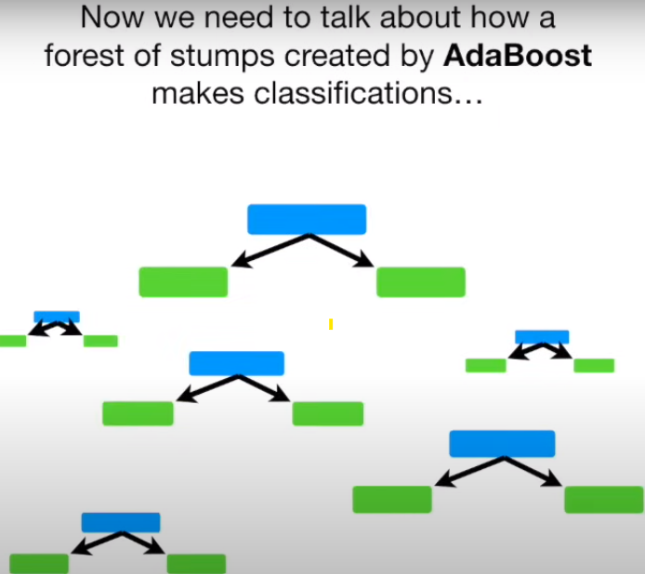
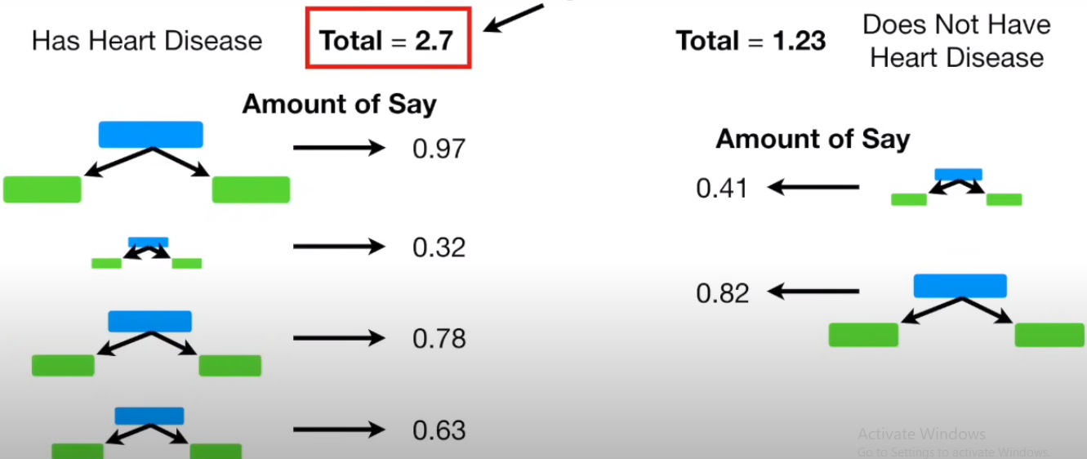
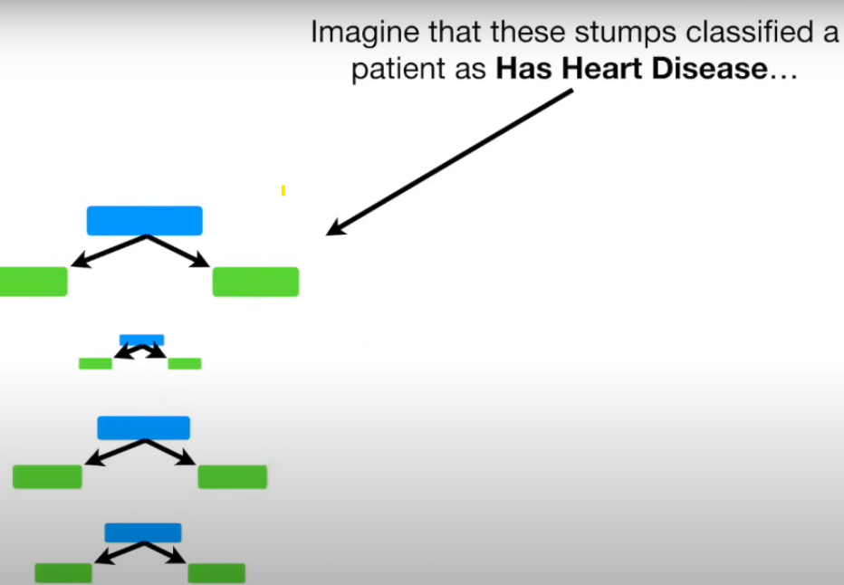
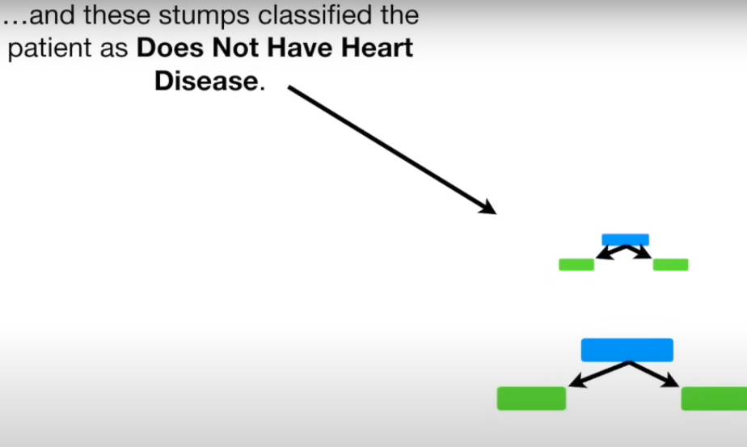
HOW IT WORKS….

